Slide 1
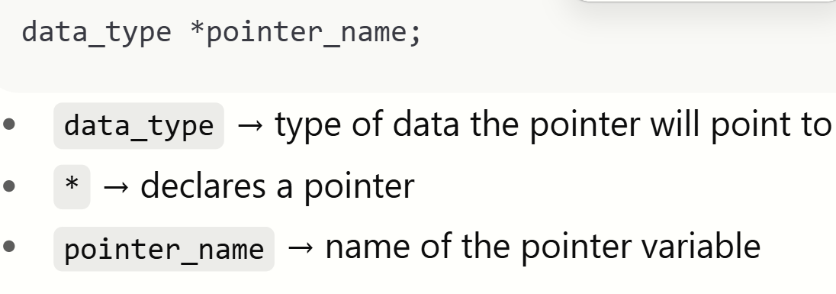
Pointer
A pointer in C is a variable that stores the memory address of variable.

Slide 2
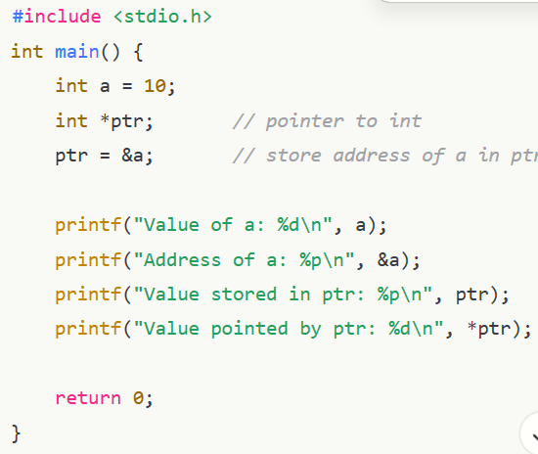
I/O with Pointer

Slide 3
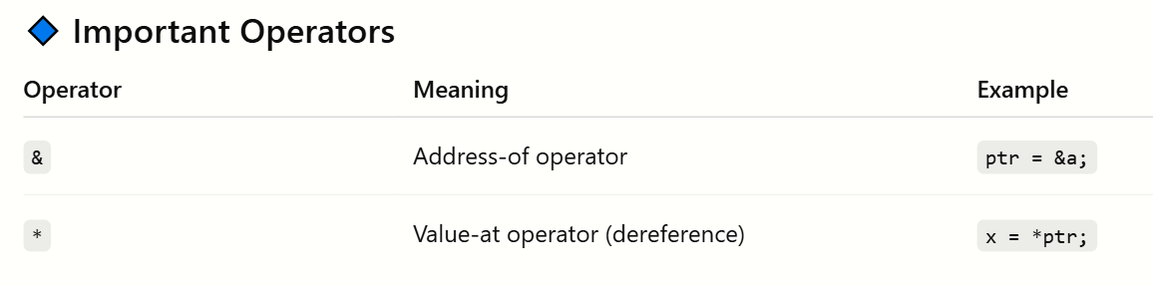
Pointer Types
int *p = ‘\0’;
void Pointer

Slide 4
void pointer:
A void pointer in C is a special type of pointer that can hold the address of any data type variable.
Can access value using Type casting.

Slide 5
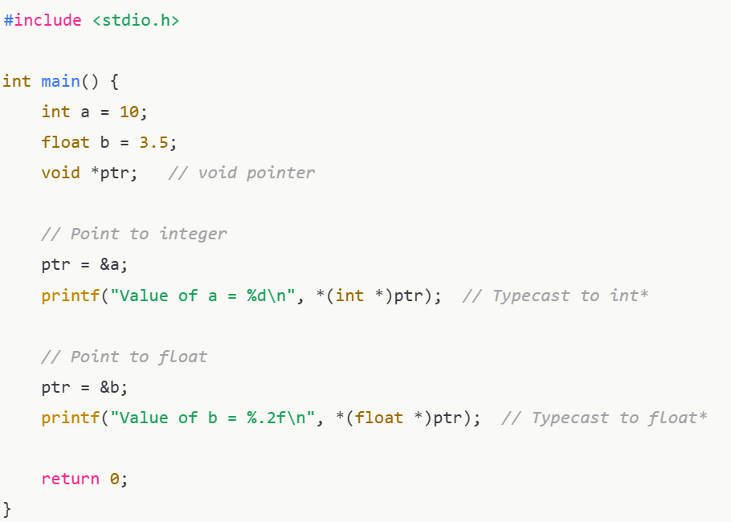

Slide 6
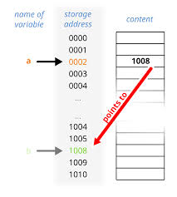
Pointer arithmetic
Addition
Subtraction
Used to Move Pointer Forward or Backword.

Slide 7
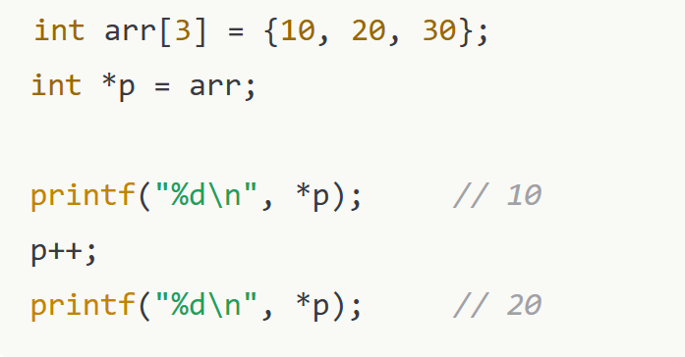
Operation Meaning
ptr++ Move to next element location
ptr-- Move to previous element location
ptr + n Move n elements locations forward
ptr - n Move n elements locations backward

Slide 8
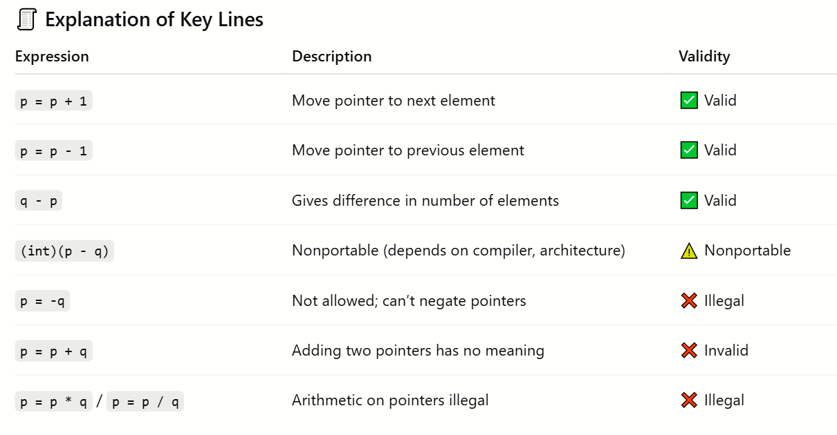

Slide 9
